Slide 1






Product portfolio
info@gltcbd.com
www.gltcbd.com
H 26, R 28, Block-K, Banani, Dhaka, Bangladesh
Ishwardi Export Processing Zone, Ishwardi, Bangladesh

Slide 2


Founder’s vision
What sets us apart
Global Tobacco Limited was established as part of the broader industrial vision of Jamil Group, a diversified Bangladeshi conglomerate with decades of experience across manufacturing, trading, and export-oriented industries. Built on a foundation of disciplined governance, operational excellence, and long-term value creation, Jamil Group has consistently focused on developing businesses that meet international standards and compete confidently in global markets.
The inception of Global Tobacco Limited was driven by a clear objective—to create a world-class cigarette manufacturing platform capable of serving international markets with consistency, flexibility, and uncompromised quality. From the outset, the founders emphasized export-grade manufacturing, ethical sourcing, and regulatory compliance as non-negotiable pillars of the business.
Drawing on Jamil Group’s extensive experience in large-scale operations and cross-border trade, GTL was designed to operate with a global mindset—adapting to diverse consumer preferences, regulatory frameworks, and market dynamics. The vision extends beyond volume production; it is centered on building long-term partnerships with distributors and brand owners through reliability, customization, and trust.
Today, this founding vision continues to guide GTL’s growth—combining industrial discipline, blend expertise, and manufacturing precision to deliver cigarette products that meet the evolving demands of global markets.
Export-Focused Manufacturing
Designed exclusively for international markets with global quality benchmarks
Blend Flexibility & Customization
Various blends, flavors, and formats including True American Blend, Virginia Blend, Chinese-style blend
Duty-Free Advantage
No import duty for sourcing of premium raw materials through EPZ operations.
DIET & Toasted Burley
Expertise in blends with our in-house DIET and Toasted Burley plant
Our global footprint

Slide 3

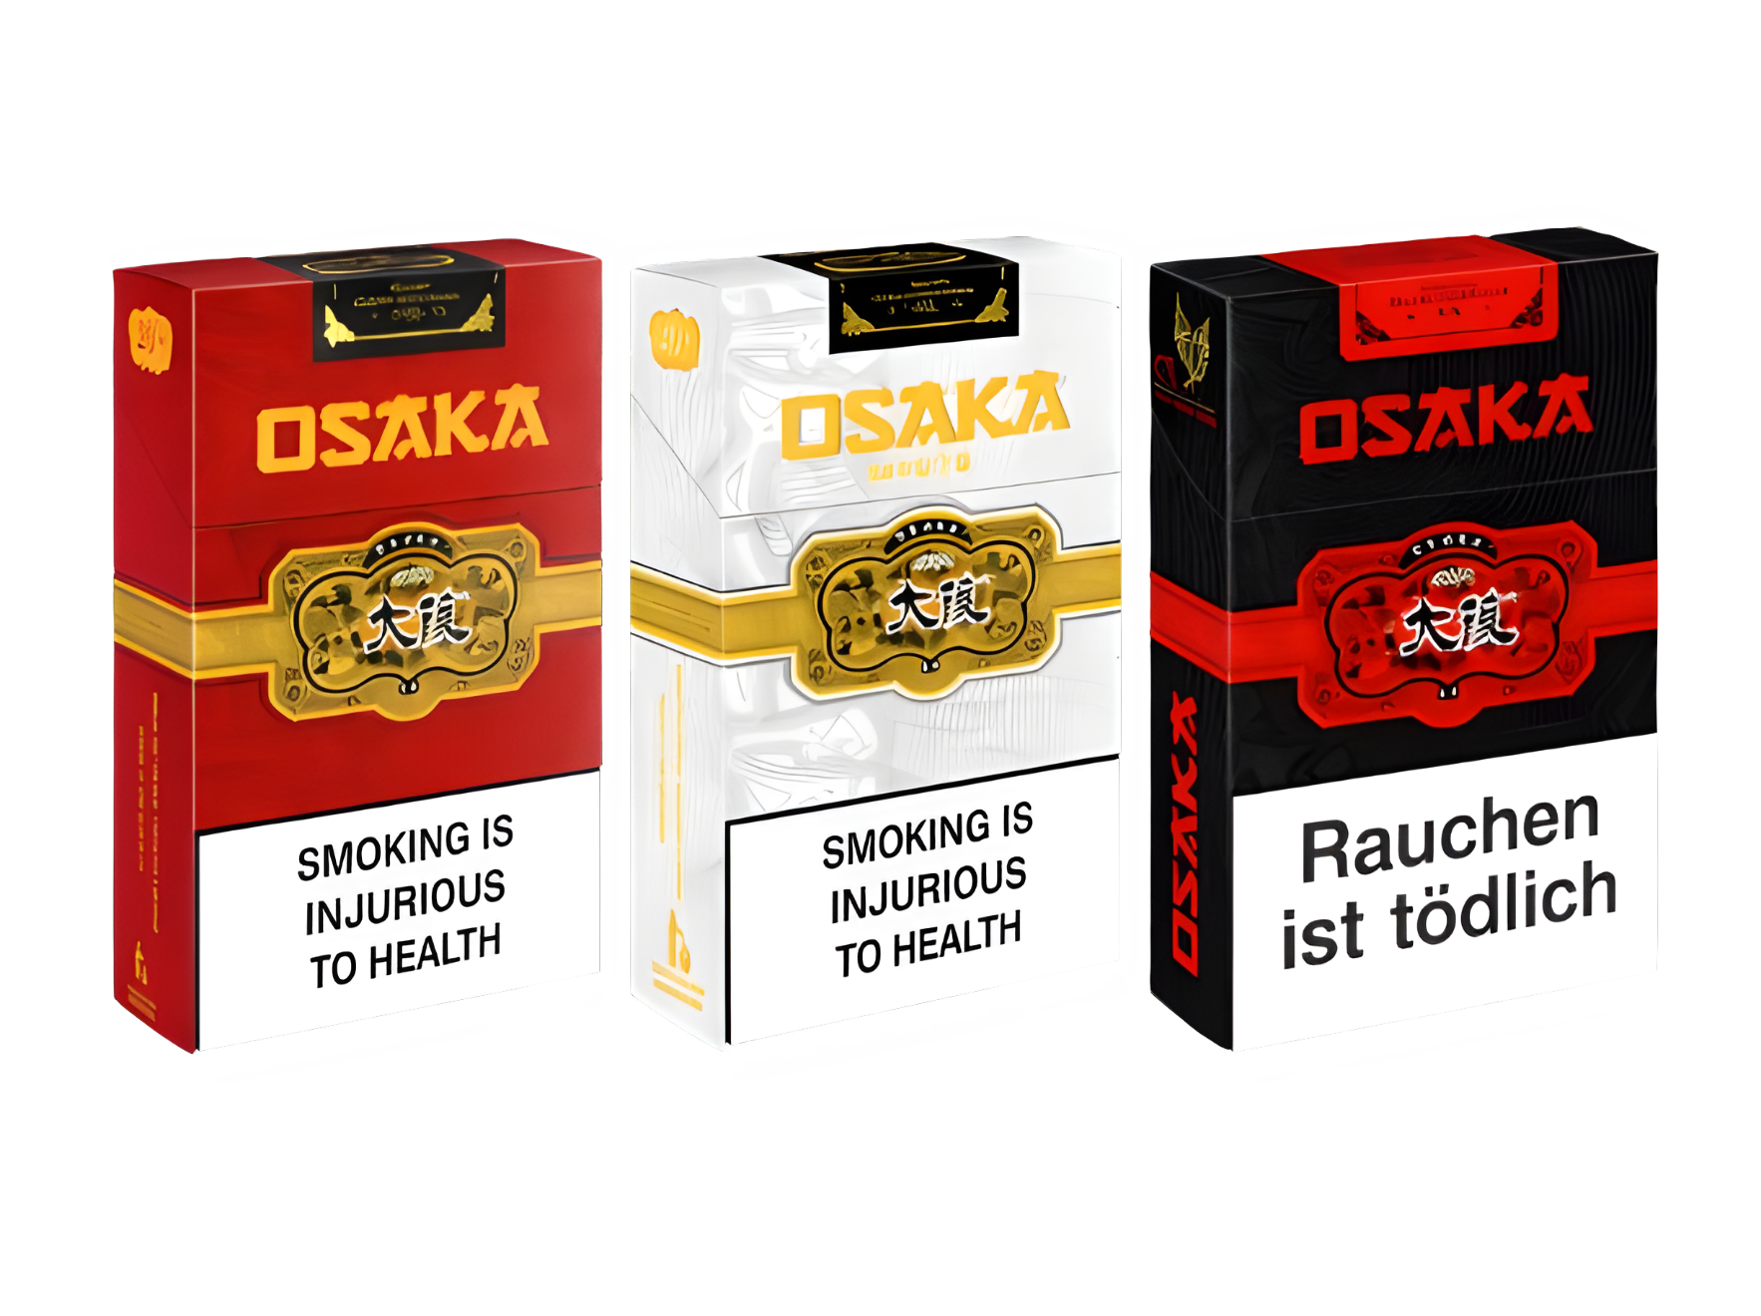

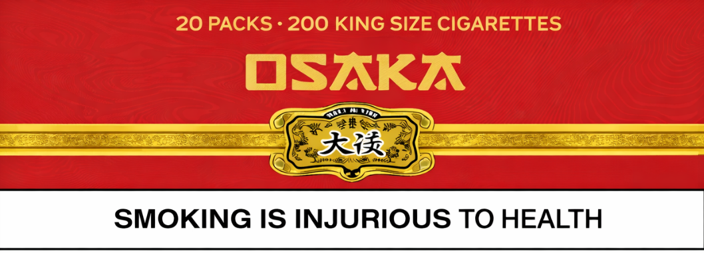

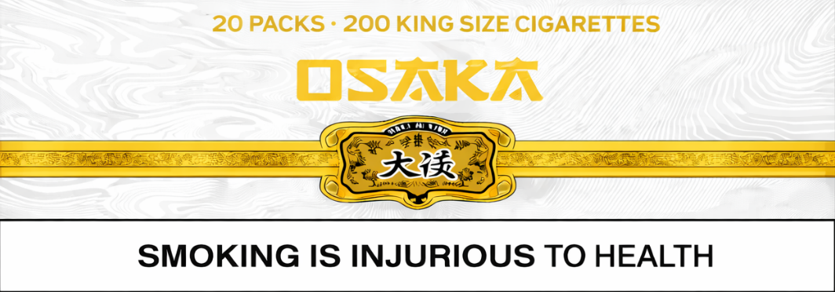

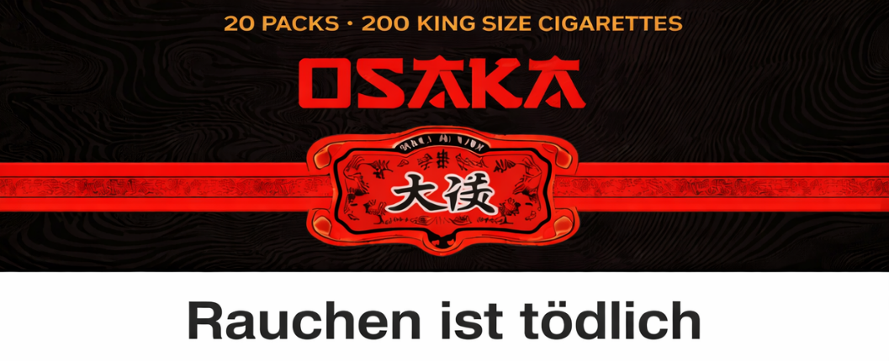

Packing: Hinge Lid Pack
Type: Box Corner
Blend: Virginia Blend
Length(mm): 83
Diameter(mm): 7.8
Packing: Hinge Lid Pack
Type: Box Corner
Blend: Virginia Blend
Length(mm): 83
Diameter(mm): 7.8
Packing: Hinge Lid Pack
Type: Box Corner
Blend: Virginia Blend
Length(mm): 83
Diameter(mm): 7.8
KING Size
10,000
20 ft 400 MC
7-6-7
Collation
Hard Outer Pack
Transparent Outer Pack
20
200
40 ft 1,000 MC
20 mm
63 mm
Single Pack
Outer Case
Master Case
Container

Slide 4

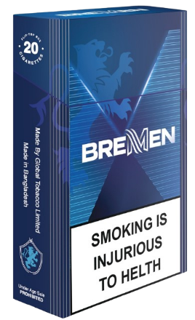


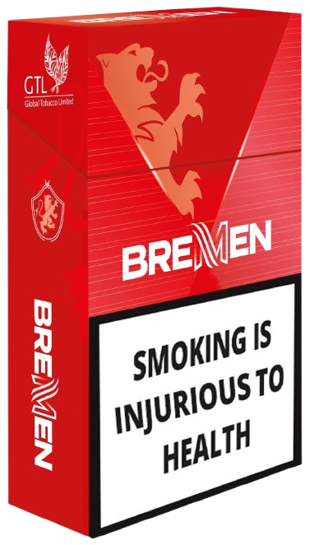

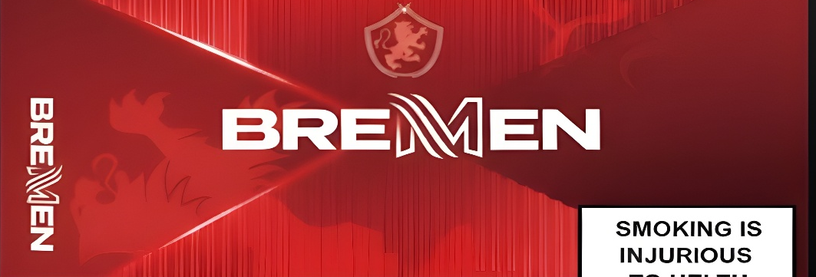
Packing: Hinge Lid Pack
Type: Box Corner
Blend: Virginia Blend
Length(mm): 83
Diameter(mm): 7.8
Packing: Hinge Lid Pack
Type: Box Corner
Blend: Virginia Blend
Length(mm): 83
Diameter(mm): 7.8
KING Size
10,000
20 ft 400 MC
7-6-7
Collation
Hard Outer Pack
Transparent Outer Pack
20
200
40 ft 1,000 MC
20 mm
63 mm
Single Pack
Outer Case
Master Case
Container

Slide 5






Packing: Hinge Lid Pack
Type: Box Corner
Blend: American Blend
Length(mm): 83
Diameter(mm): 7.8
Packing: Hinge Lid Pack
Type: Box Corner
Blend: American Blend
Length(mm): 83
Diameter(mm): 7.8
KING Size
10,000
20 ft 400 MC
7-6-7
Collation
Hard Outer Pack
Transparent Outer Pack
20
200
40 ft 1,000 MC
20 mm
63 mm
Single Pack
Outer Case
Master Case
Container

Slide 6

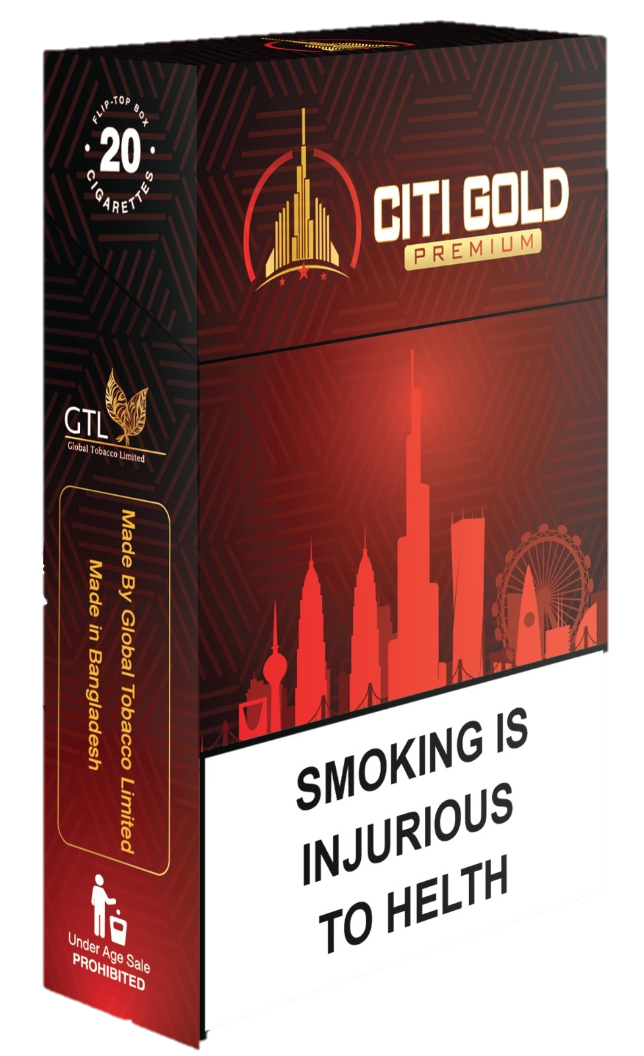


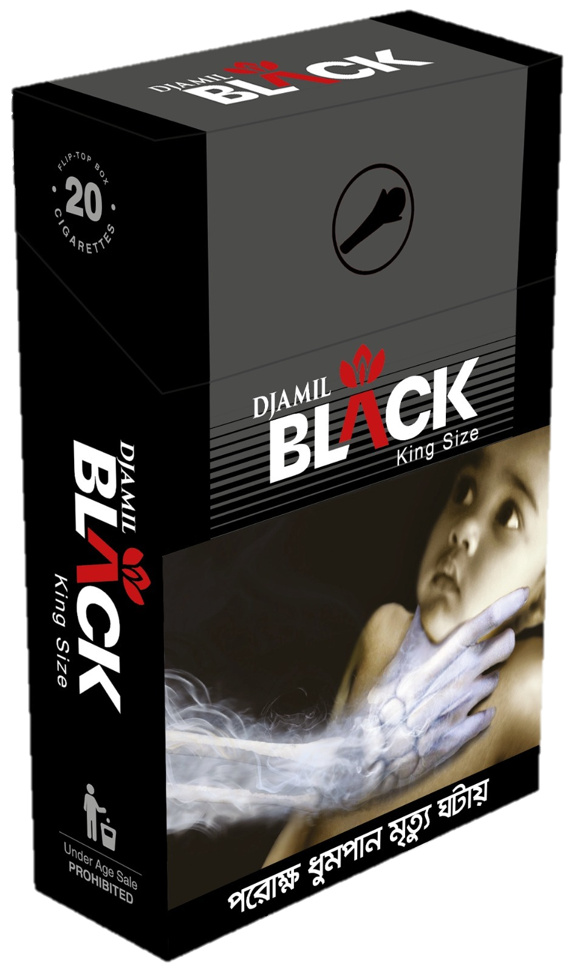
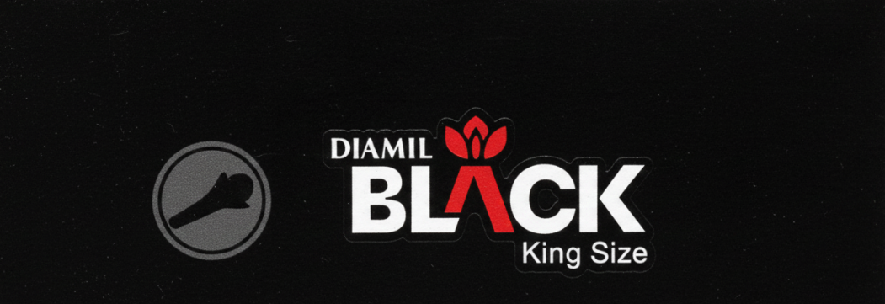

Packing: Hinge Lid Pack
Type: Box Corner
Blend: Virginia Blend
Length(mm): 83
Diameter(mm): 7.8
Packing: Hinge Lid Pack
Type: Box Corner
Blend: Kretek
Length(mm): 83
Diameter(mm): 7.8
KING Size
10,000
20 ft 400 MC
7-6-7
Collation
Hard Outer Pack
Transparent Outer Pack
20
200
40 ft 1,000 MC
20 mm
63 mm
Single Pack
Outer Case
Master Case
Container

Slide 7

